Slide 1
Trouble Shooting
DC Inverter LCAC
11/2020
Five .Yang
Technical support department

Slide 2

CONTENT
Error code
Trouble shooting guide
Necessary tools
1.Multimeter
2. Current clamp
3. Thermometer
Part 1
Part 2

Slide 3
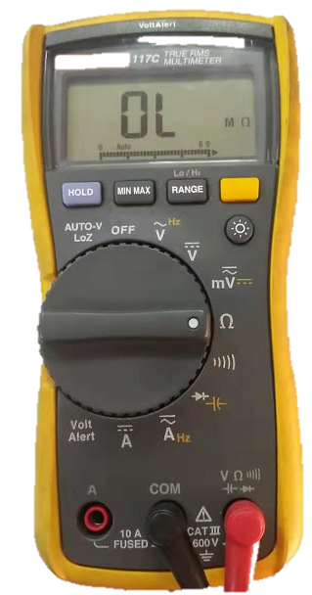
1.Multimeter
Function ：test resistance , current , voltage ,etc.
1. Rest to “OFF” before start testing
2. Switch to V before testing voltage.
Note：Choose DC or AC according to demand
3. Switch to Ω to test resistance.
4. Switch to A to test current
Note：Choose DC or AC according to demand

Slide 4
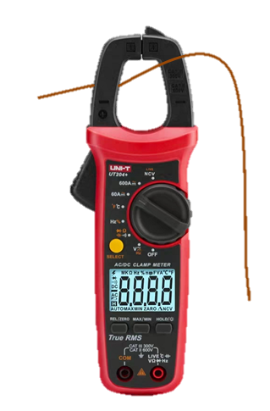
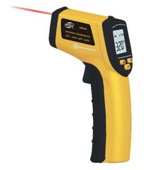
2. Current clamp
3. Thermometer
Function： Test running current
Function：
Test air inlet & outlet temperature
Note: Single-core wires go through the current clamp

Slide 5
CONTENT
Error code
Trouble shooting guide
Necessary tools
1.Multimeter
2. Current clamp
3. Thermometer
Part 1
Part 2

Slide 6

CONTENT
Error code
Trouble shooting guide
CODE | Fault code description
A1 | Fault with the room temperature sensor on the indoor unit
A2 | Fault with the temperature sensor in the Middle evaporator of indoor unit
C1 | Fault with the ambient temperature sensor on the outdoor unit
C3 | Fault with the discharge temperature sensor on the outdoor unit
C6 | Fault with the suction temperature sensor on the outdoor unit
C8 | Fault with the temperature sensor in the middle of Outdoor condenser
C2 | Fault with the defrosting temperature Sensor on the outdoor unit
Temp. sensor fault (7)
Communication fault (4)
Indoor unit fault (10)
Refrigerant circuit fault (3)
ODU component fault (3)
ODU electric control fault (16)

Slide 7
1. Where are these sensors？
C8 condenser mid temperature sensor-20K
C2 condenser defrost temperature sensor-20K
C1 ambient temperature sensor -15K
A1 room temperature sensor is abnormal -15K
A2 evaporator mid temperature sensor -20K
C6 suction temperature sensor -20K
48.60k refrigerant diagram reference
C3 discharge temperature sensor -50K

Slide 8
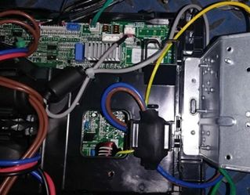
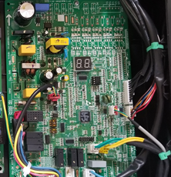
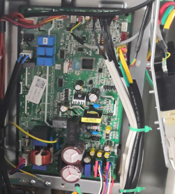
1. Where are these sensors？
ODU Model | Temperature sensor specification
AL-H12A4/R3VDS1-C2 | 16430007000239 temperature sensor group 15K/20K/50K3950XH10 ( Contains all ODU temperature sensors )
AL-H18A4/R3VDS1-C2
AL-H24A4/R3VDS1-C2
AL-H30A4/R3VDS1-C2
AL-H36A4/R3VDS1-C2
AL-H42A4/R3VDS1-C2
AL-H48A5/R3VDS1-C2 | 16430007000201 temperature sensor group ( Contains all ODU temperature sensors )
AL-H60A5/R3VDS1-C2

Slide 9
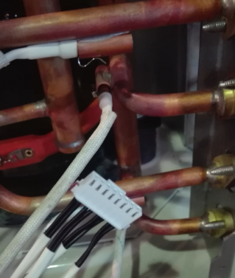
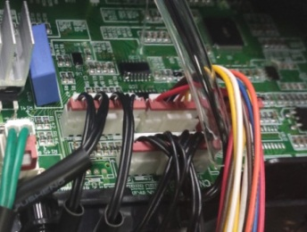
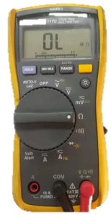
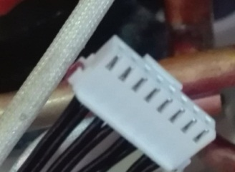
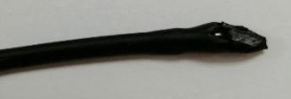
2. Trouble shooting reference
1. the connection of sensor plug is firm or not ?- -reconnect
Sensor plug
Sensor connection port
2. the connection of sensor is loose or short circuit ? - -
reconnect
Sensor resistance at 25°C | Resistance comparison table
15KΩ
20KΩ
50KΩ
4. Check whether the sensor is broken ?
Sensor value refer to sensor resistance table
3. Check whether the wiring is broken ? – replace

Slide 10
CONTENT
Error code
Trouble shooting guide
Temp. sensor fault (7)
CODE | Fault code description
A9 | Communication abnormal between IDU and ODU
J2 | Communication abnormal between ODU and IDU
AA | Communication abnormal between IDU and wired controller
J3 | Communication abnormal between the driver PCB and main PCB of ODU
Communication fault (4)
Indoor unit fault (10)
Refrigerant circuit fault (3)
ODU component fault (3)
ODU electric control fault (16)

Slide 11
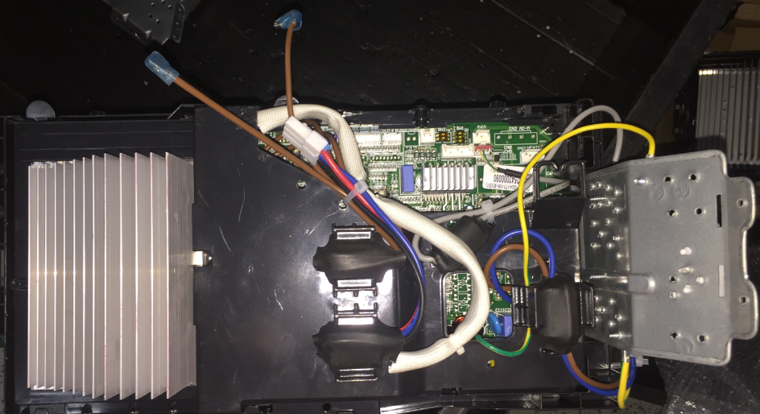
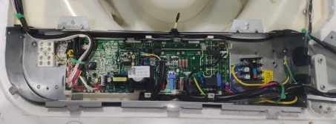
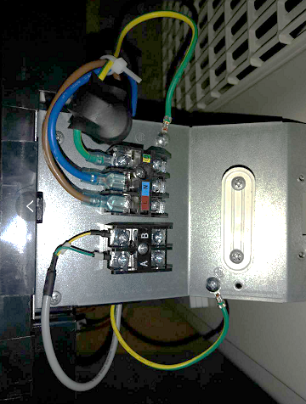
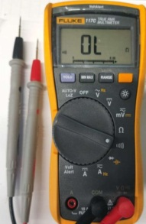
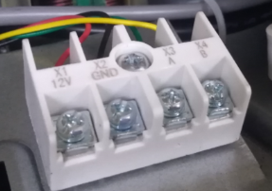
1. A9/J2 Communication abnormal between the ODU and IDU
Error logic : IDU & ODU detect signal feedback from each other , if no signal will appear error code
1. Check communication wiring of IDU terminal and ODU terminal, ensure A to A or (x3) , B to B or (x4）
A or (x3)
B or (x4)
A or (x3)
B or (x4)
18K ODU (reference)
Y type cassette (reference)
Check whether communication wiring abnormal through multi-meter (some cases that the wire be bitten off by animals)
ODU PCB
IDU PCB
2.2 test follow the photo connection by multi-meter, If there is no sound , means wire is abnormal, try to change new wire
※ Continuous beep means wire is normal
3.Check whether IDU PCB abnormal, keep power on
Test DC voltage between A and GND or (x2) , B and GND or (x2)
※ PCB is normal ： Voltage will keep 3.7V (A side) ; 0-1V（B side)
※ PCB is abnormal : Voltage will keep 5V (A side); 0V (B side)
2.1 Short connection
4. Check whether ODU PCB abnormal
try to replace new ODU PCB

Slide 12
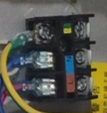
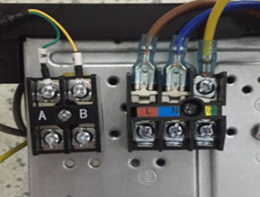
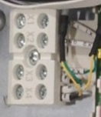
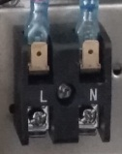
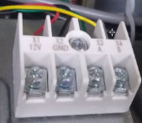
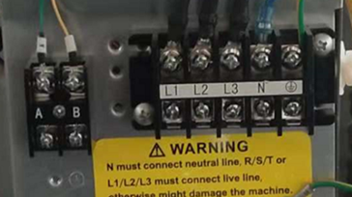
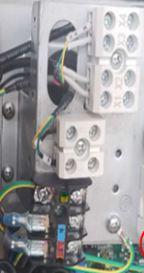
Photos of communication terminal
IDU communication terminal |  | ODU communication terminal
Y type cassette |  | Signal phase
F type Ceiling floor
 |  | Three phase
M type Mid ESP Duct
X3 X4
To ODU [A, B] terminal
To IDU [A, B] or [X3,X4] terminal
X3 X4
A B
To ODU [A, B] terminal
To IDU [A, B] or [X3,X4] terminal
A B
To ODU [A, B] terminal

Slide 13
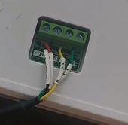
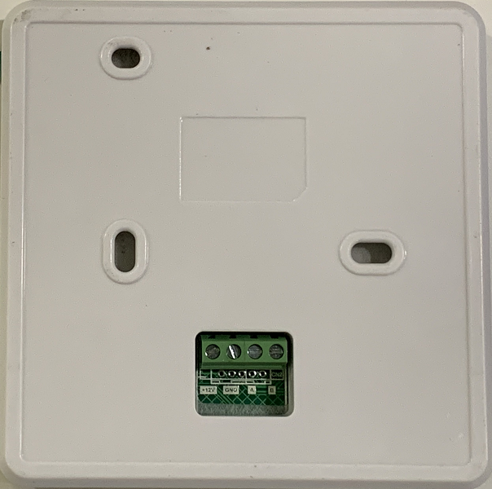
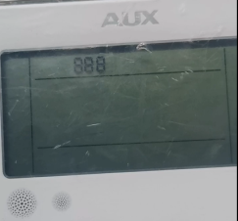
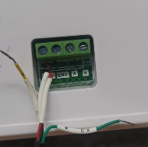
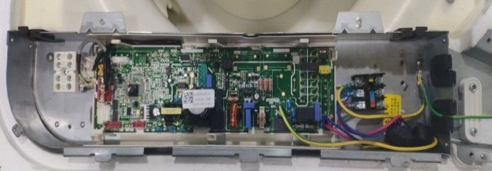
2. AA Communication abnormal between IDU and wired controller
1. Check communication wiring between IDU terminal and wired controller, same method by use multi-meter test follow Page 16 ( point 2)
Wired controller
Wrong wire
NO wire to A,B
Appear 888 8
2. Try replace a new IDU PCB
4core*5m
※ If green & yellow signal wire wrong connection or disconnection , it will appear 888 8,
※ 888 8 may appear in a short time after starting, but it will disappear
3. Try replace a new wired controller
Y type cassette control box (reference)

Slide 14

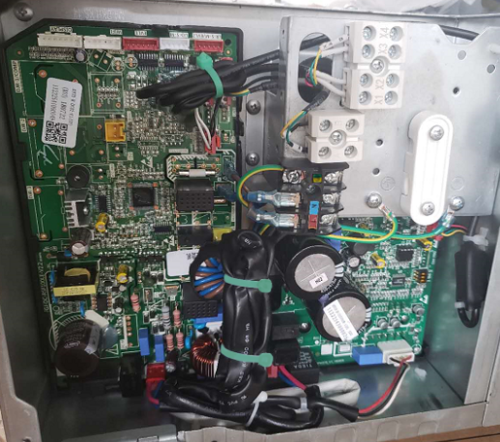
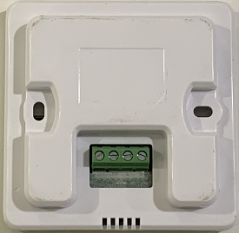
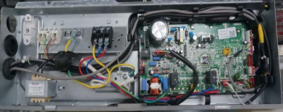
Photos of wired controller wiring terminal
IDU communication terminal
Y type cassette |  | M type Mid ESP Duct
F type Ceiling floor
(4 core wiring )
(4 core wiring )
XK-04 （86）
XK-05（120）
XK-04 （86）
XK-05（120）
(4 core wiring )
XK-04 （86）
XK-05（120）

Slide 15
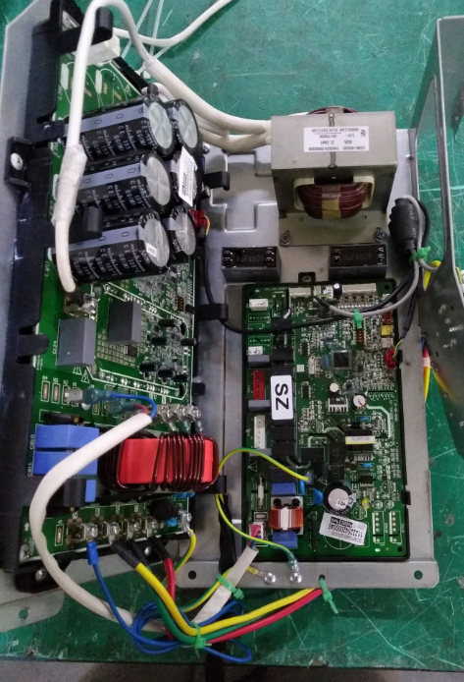
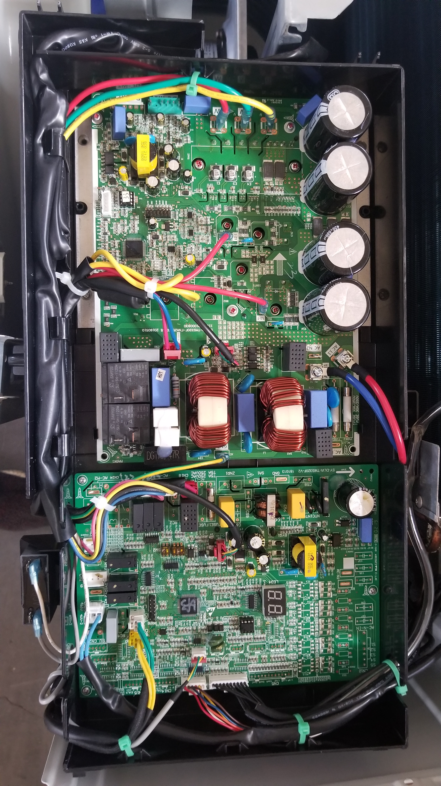
3. J3 Communication abnormal between the driver PCB and main PCB of ODU
Error logic : no signal between them, then J3 error will be displayed
48/60K ODU
1. Check whether communication wire abnormal
Communication wire between Drive PCB and Main PCB
30/36/42K ODU
2. Try to replace new drive PCB
3. Try to replace new main PCB
Drive PCB
Main PCB
Drive PCB
Main PCB
※ No individual Drive PCB for 12,18,24K ODU

Slide 16
CONTENT
Error code
Trouble shooting guide
CODE | Fault code description
A5 | Indoor unit water pump abnormal (Fault with the drainage)
A6 | Indoor unit fan motor abnormal
A8 | Indoor unit EEPROM module failure
99 | Communication error between the drive PCB and main PCB of the indoor unit
9A | Temperature protection of indoor drive PCB
9H(9B) | Failure of indoor DC fan start up
9C | Over current protection of indoor DC fan motor
9J(9D) | Overvoltage and under voltage protection of indoor DC fan motor
9E | IPM protection for drive PCB of indoor DC fan motor
9F | EE protection for drive PCB of indoor DC fan motor
Temp. sensor fault (7)
Communication fault (4)
Indoor unit fault (10)
Refrigerant circuit fault (3)
ODU component fault (3)
ODU electric control fault (16)

Slide 17
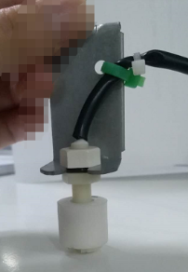
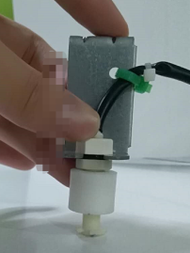
1. A5 Indoor unit water pump abnormal (Fault with the drainage)
Error logic : float switch ports on PCB are normally connected circuit ,
once be disconnected then A5 will be displayed
Float switch working diagram
to PCB – connected circuit
to PCB – disconnect circuit (appear A5)
Float to down-side
Float to up-side
water drainage pan
Full of water

Slide 18
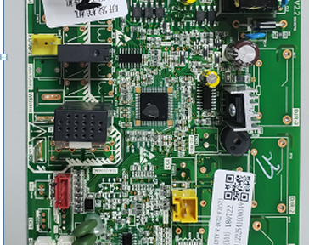
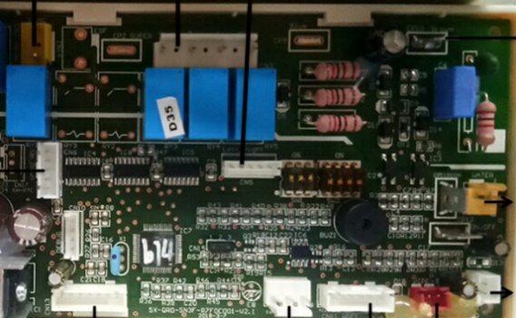
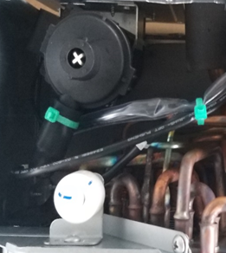
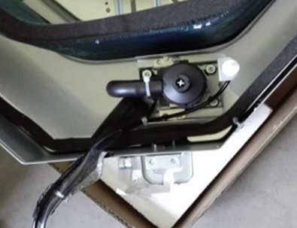
A5 Water pump wiring
Water pump port
Water pump port
Water pump
Water pump
Float switch
Float switch
Float switch port
Float switch port
Duct unit
(reference)
Cassette unit (reference)

Slide 19



A5 Trouble shooting flow chart
Check PCB
Remove float switch wiring, short connect Float switch port
Replace
PCB
Error
exists
A5 error
no error
Check water drainage pan
Whether full of water
Check float switch
Manual change the float to up and down (＞1 min)
No
Replace
Float switch
Error
exists
yes
Up-error
Down – no error
A5 come again
after a while
Adjust the water drainage pipe or clean the water drainage pan
Check the drain pump
Whether it can drain water normal
Replace the drain pump
abnormal
※ If error appear after change a new PCB （no A5 before）,please contact to factory and check the parameter setting

Slide 20
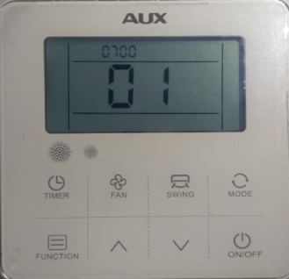
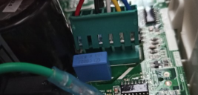
2. A6 Indoor unit fan motor abnormal
Error logic :
When the fan motor is abnormal, the detected current is too large over than the protection value,
When the hardware of PCB is broken, the main chip will detect the fault signal sent by the motor
A6 error
Check Fan motor wiring
Whether the connection port of fan motor is loose
No
Check fan motor
Replace a new fan motor
Replace a new
PCB
Error exist
※ Before change a new PCB ,had better check and record the previous parameters on this IDU by RS485 wired controller
※ After changed new PCB , check parameters and keep same setting as previous value
Reconnect the wire

Slide 21
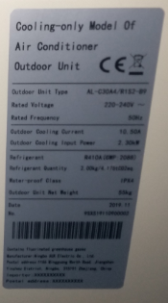

3. A8 Indoor unit EEPROM module failure
Error logic :
When the IDU parameter setting abnormal , then will appear A8
A8 error
Share IDU &ODU nameplate photos to factory
Check parameter ( 07# & 12# ） by wired controller and share photos to technical
Get the correct parameter and change
Contact to technical

Slide 22
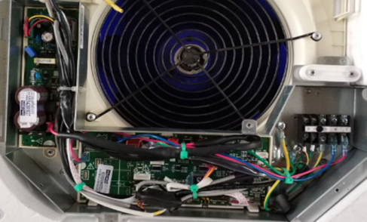
4. 99 Communication error between the drive PCB and main PCB of the indoor unit
Error logic : no signal between them, then 99 error will be displayed
1. Check whether communication wire abnormal
Duct unit
Communication wire between Drive PCB and Main PCB
12/18K cassette
2. Try to replace new drive PCB
Drive PCB
3. Try to replace new main PCB
Main PCB
Drive PCB
Main PCB
※ Intergrade ( drive PCB and main PCB) for 24-60K cassette and ceiling floor IDU

Slide 23
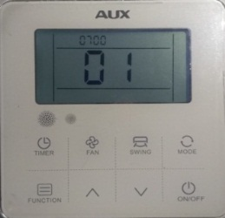
5. 9A 、9H(B)、9C、9J(D)、9E、9F
9A
Temperature protection of indoor drive PCB
9H(9B)
Failure of indoor DC fan start up
9C
Over current protection of indoor DC fan motor
9J(9D)
Overvoltage and under voltage protection of indoor DC fan motor
9E
IPM protection for drive PCB of indoor DC fan motor
9F
EE protection for drive PCB of indoor DC fan motor
Restart , check whether fan motor work normal or not
if the error just appear once in a while , no need to replace PCB or fan motor
Check parameter 1-15# value ,whether match the default setting
if the error appear frequently
fan motor work
normal
Parameter is
normal
Try replace a new Drive PCB
Parameter is
abnormal
Try to reset default parameter
fan motor work abnormal
Try replace a new fan motor

Slide 24
CONTENT
Error code
Trouble shooting guide
Temp. sensor fault (7)
Communication fault (4)
Indoor unit fault (10)
CODE | Fault code description
E3 | Discharge temperature too high protection
FH | Discharge temperature too low protection
E8 | Cooling: High temperature protection of ODU Heating: High temperature protection of IDU
Refrigerant circuit fault (3)
ODU component fault (3)
ODU electric control fault (16)

Slide 25
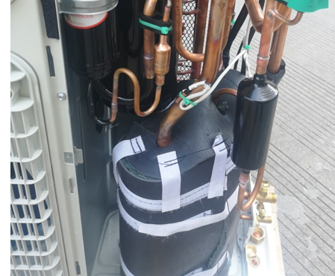
1. E3 Discharge temperature too high protection
Error logic
Compressor discharge temperature sensor “Td” detected ≥115℃ and Lasts for 10s, whole system will stop run to protect compressor, then E3 error be display
48&60K ODU Reference
Exhaust (Discharge)
Temperature sensor

Slide 26
E3 Trouble shooting flow chart reference
Check fan motor
Whether IDU and ODU fan can run normally
E3 error
Replace
Fan motor
no
yes
Check temperature sensor
check exhaust piping temperature
High
Check installation of ODU
Whether poor heat exchange of ODU
Improve installation
Low
temperature
Replace
sensor
no
Check the refrigerant system
Whether poor performance of indoor
Yes
Vacuum pump, Check Air tightness, recharging refrigerant
Abnormal noise of compressor
Error again
Replace compressor

Slide 27
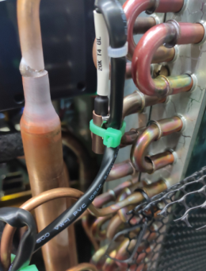
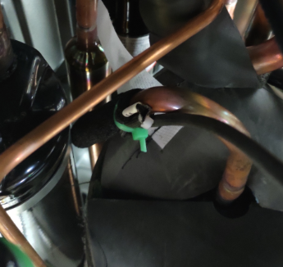
2. FH Discharge temperature too low protection
Error logic
The temperature difference between discharge temperature “Td” and condenser mid temperature “Tcm” less than the protection value(super heat), will stop run to protect compressor ,then FH will be displayed
48.60k refrigerant diagram reference

Slide 28
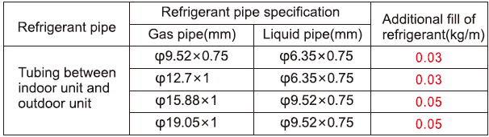
FH Trouble shooting reference
Check the liquid piping whether short length ( factory test is 5m , too short piping length may cause protection )
--- Remove some refrigerant
2. Check whether indoor fan work normal or not ( fan not work will cause liquid refrigerant back to compressor )
--- Replace fan motor or fan wheel
3. Ensure add refrigerant according instruction manual , no excessive refrigerant
48.60k refrigerant diagram reference

Slide 29
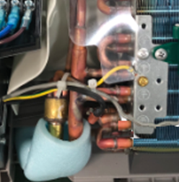
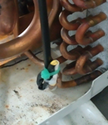
3. E8 High temperature protection of IDU and ODU
Error logic
Cooling : condenser sensor “Tcm” or defrosting sensor “Tdef” detected temperature value over the protection value
Heating: evaporator mid temperature sensor “Tem” detected temperature over the protection value
will stop run due to run out range of compression ratio, E8 will be displayed
48.60k refrigerant diagram reference
Notes:
胡立志确认逻辑

Slide 30
E8 Trouble shooting reference
Cooling mode error
2. Check whether condenser side blocked or dirty ( poor heat exchange)
3. Power reset , turn on unit , check whether fan motor or fan not working
1. Check whether stop valve full opened, ensure full opened
48.60k refrigerant diagram reference
4. Check whether EXV abnormal (closed), --replace it
Notes:
赵攀确认

Slide 31
E8 Trouble shooting reference
Heating mode error
Check whether evaporator side blocked or dirty ( poor heat exchange)
2. Power reset , turn on unit , check whether IDU fan motor or fan not working
Heating refrigerant
flow direction
Heating refrigerant
flow direction
3. Check whether EXV abnormal (closed),
--replace it
Heating refrigerant
flow direction
48.60k refrigerant diagram reference
Notes:
赵攀确认排除方法

Slide 32
CONTENT
Error code
Trouble shooting guide
Temp. sensor fault (7)
Communication fault (4)
Indoor unit fault (10)
CODE | Fault code description
H1 | High pressure Switch Protection
H4 | Low pressure switch protection
E1 | Fault of four way valve
Refrigerant circuit fault (3)
ODU component fault (3)
ODU electric control fault (16)

Slide 33


1. H1 High pressure switch protection
2. H4 Low pressure switch protection
HP and LP switch connection ports on PCB are normally closed circuit ,
once be disconnected then H1 and H4 will be displayed
ODU | High pressure switch | Low pressure switch
12,18,24K | No | √
30.36.42.48.60K | √ | √
0.05±0.04Mpa off/disconnected
LP switch
LP switch Port
HP switch
HP switch Port
4.2±0.15Mpa off/disconnected
Main PCB( 30.36,42K reference)
Notes:
扶胜根提供逻辑

Slide 34

H1、 H4 Trouble shooting flow chart reference
Check HP/LP switch
Reconnect switch wiring to PCB，power reset
Replace
HP/LP switch
Error
exists
H1、 H4 error
No error
Check HP/LP port and PCB
Remove wiring， short connect two
Point, then power reset ,
No error
Check installation of ODU
Whether poor heat exchange of ODU
Improve installation
Yes
Error Still exists
No
Replace PCB
Check the refrigerant system
Whether poor performance of indoor side
Whether abnormal current、 high pressure value
Vacuum pump, Check Air tightness, recharging refrigerant

Slide 35
3. E1 Fault of four way valve
Error logic
Heating mode：evaporator mid temperature sensor “Tem” detected temperature big different with normal value,
E1 will be displayed
Normal evaporator temperature about 40℃ in heating mode
48.60k refrigerant diagram reference

Slide 36


E1 Trouble shooting flow chart reference
Four way valve connection port, no input signal
1. Check Whether the connection port is loose
Yes
Reconnect
no
no
2. Remove wiring, test port whether had 220V~ voltage
Replace PCB
Output 220V~
Yes
E1 error
3. Replace a new FWV coil
and reset heating mode
Replace FWV

Slide 37
CONTENT
Error code
Trouble shooting guide
31 | Fault with the inverter module protection
34 | Compressor start failure
3E | Compressor drive PFC hardware protection
32 | Compressor drive hardware protection
33 | Module software protection
37 | Fault with the modular temperature sensor on the ODU
3F | Compressor drive PFC hardware protection
J7 | Fault with the outdoor unit EPROM
3H | Fault with fan motor of outdoor unit
3C | Overcurrent protection of outdoor DC fan motor
3J | Overvoltage protection of outdoor DC fan motor
41 | IPM protection for driving board of outdoor DC fan motor
35 | Fault with the over electric current protection
39 | Protection of compressor driving module for excessive temperature
36 | Fault with the over-voltage or low-voltage protection
38 | Fault with compressor power supply phase deficiency protection
Temp. sensor fault (7)
Communication fault (4)
Indoor unit fault (10)
Refrigerant circuit fault (3)
ODU component fault (3)
ODU electric control fault (16)

Slide 38

1. 31、34、3E
Detect logic :PCB detects the current feedback signal before compressor start .
When abnormal current is detected (the current is too large), 34/ 3E/31 will be displayed
31
Fault with the inverter module protection
34
Compressor start failure
3E
Compressor drive PFC hardware protection
Try replace a new drive PCB
Try replace a new compressor
48.60k ODU reference

Slide 39

2. 32 、33、3F、37、J7
32
Compressor drive hardware protection
33
Module software protection
3F
Compressor drive PFC hardware protection
37
Fault with the modular temperature sensor on the ODU
J7
Fault with the outdoor unit EPROM
Replace a new drive module
48/60K ODU
30/36/42K ODU
12/18/24K ODU
Drive PCB
Main PCB
Drive PCB
Main PCB
Intergrade PCB
Notes:
胡立志确认

Slide 40





3. 3H 、3C、3J、41
3H
Fault with the Fan motor of outdoor unit
3C
Overcurrent protection of outdoor DC fan motor
3J
Overvoltage protection of outdoor DC fan motor
41
IPM protection for driving board of outdoor DC fan motor
Replace a new fan motor to check first,
if error exist, then replace a new PCB
12~30K
36, 42K
48.60k
Notes:
胡立志确认

Slide 41
4. 35、39
35
Fault with the over electric current protection
39
Protection of compressor driving module for excessive temperature
Over current error detect logic:
Due to poor signal of input AC voltage or unstable voltage cause high current
Temperature too high error detect logic:
Built in temperature sensor detect over 105℃
Check whether unstable input voltage
Check whether poor heat exchanger of ODU , cause high temperature of electric control box
No
No
Try to replace a new drive PCB
48/60K ODU
30/36/42K ODU
12/18/24K ODU
Drive PCB
Main PCB
Drive PCB
Main PCB
Intergrade PCB
Notes:
胡立志确认

Slide 42


5. 36 Over-voltage Protection of the compressor drive modular
Trouble shooting reference for single phase unit
ODU Power terminal
Over-AC voltage range:
＞290V
＜125V
1. Test power supply terminal L and N,
2. If test voltage range between 125 and 290 V，and 36 not disappear , then replace a new drive PCB
※ If drive PCB is normal , 36 error will disappear after voltage within normal range last for 2 min
Notes:
胡立志确认

Slide 43



36 Trouble shooting reference for three phase unit
Over-DC voltage range:
＞750V
＜250V
1. Test drive PCB voltage port as the photo
2. If test DC voltage range between 250 and 750 V, and 36 not disappear,
----- then replace a new drive PCB
※ If drive PCB is normal , 36 error will disappear after voltage within normal range last for 2 min
Notes:
胡立志确认

Slide 44




6. 38 Fault with compressor power supply phase deficiency (lack) protection
Trouble shooting reference for single phase unit
compressor wire1#
compressor terminal board
Compressor port
Connection
compressor wire 2#
3.Check whether compressor wire2# abnormal --- Replace new wire
Error exists
2.Check whether compressor wire1# abnormal --- Replace new wire
If Error still exists after restart
Error exists
4.Try to replace new PCB
1.Check whether compressor terminal board wire loose --- Reconnect
Notes:
胡立志确认

Slide 45


38 Trouble shooting reference for three phase ODU (48,60K)
compressor port
2.Check whether compressor port wire loose --- Reconnect
3.Replace whole compressor wire
If Error still exists after restart
Whole
compressor wire
4.Try to replace new drive PCB
1.Check whether compressor terminal board wire loose --- Reconnect
48/60K ODU reference
compressor terminal board
Notes:
胡立志确认

