Slide 1
Error Trouble Shooting
LCAC ON/OFF type
2020
Five .Yang
20200425

Slide 2
Part 1
Necessary tools
1.Multimeter
2. Current clamp
3. Thermometer

Slide 3
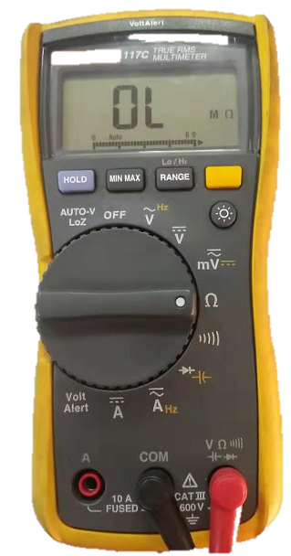
1.Multimeter
Function ：test resistance , current , voltage ,etc.
1.Rest to “OFF” before start testing
2. Switch to V before testing voltage.
Note：Choose DC or AC according to demand
3. Switch to Ω to test resistance.
4. Switch to A to test current
Note：
Choose DC or AC according to demand
Choose the appropriate range

Slide 4
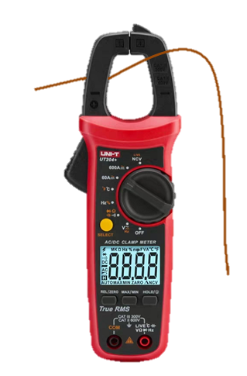
2. Current clamp
Function： Test running current
Note: Single-core wires go through the current clamp

Slide 5
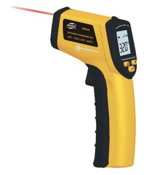
3. Thermometer
Function： Test air inlet & outlet temperature

Slide 6

Part 2
Error code trouble
shooting guide

Slide 7
Total 13 error codes
Temp. sensor fault(5)
E1 Indoor temperature sensor is abnormal
Communication fault
E3 Indoor coil sensor is abnormal
E2 Outdoor defrost sensor is abnormal
IDU fault
E7 Outdoor condensing mid temperature sensor is abnormal
Refrigerant circuit fault
E8 Discharge temperature sensor is abnormal

Slide 8
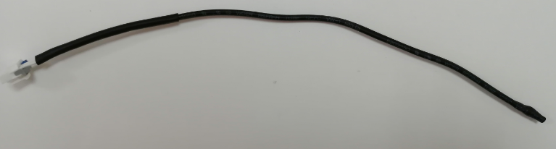
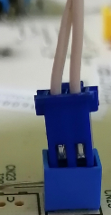
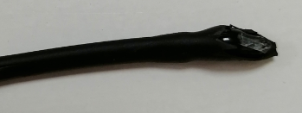
1. Trouble shooting Guide
Whether the sensor connector is loose ?
Yes
Connect the connector again
No
Yes
Is sensor broken ?
Replace sensor
No
Replace PCB
Broken
Connector is loose

Slide 9
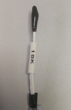

2. Where are these sensors？
E7 Outdoor condensing mid temperature sensor is abnormal
E8 Discharge temperature sensor is abnormal
E1 Indoor temperature sensor is abnormal
20k
50k
15k
E3 Indoor coil sensor is abnormal
20k
20k
E2 Outdoor defrost sensor is abnormal

Slide 10
3. Resistance comparison table
Sensor resistance at 25°C | Resistance comparison table
15KΩ
20KΩ
50KΩ

Slide 11
Total 13 error codes
Temp. sensor fault
Communication fault (2)
F1 Communication abnormal between the outdoor unit and the Indoor unit
IDU fault
E5 Communication abnormal between the wired controller and indoor unit
Refrigerant circuit fault

Slide 12
F1 Trouble shooting Guide
Check if the communication cable is broken.
Replace the communication cable
Yes
No
Check if the communication cable to the indoor and outdoor terminal boards is wrong.
Rewiring according to the wiring diagram
Yes
No
Replace ODU PCB
Yes
OVER
No
Replace IDU PCB

Slide 13
Total 13 error codes
Temp. sensor fault
Communication fault (2)
F1 Communication abnormal between the outdoor unit and the Indoor unit
IDU fault
E5 Communication abnormal between the wired controller and indoor unit
Refrigerant circuit fault

Slide 14
E5 Trouble shooting Guide
Check if the wired controller is abnormal
Replace wired controller
Yes
No
Check if the communication cable is broken.
Replace the communication cable
Yes
No
Replace IDU PCB

Slide 15
Total 13 error codes
Temp. sensor fault
Communication fault
IDU fault (1)
E4 Fault with the drainage on Indoor unit
Refrigerant circuit fault

Slide 16
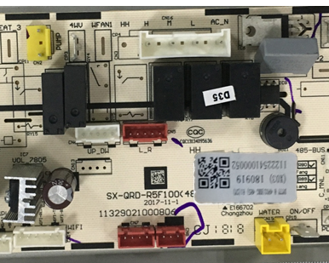
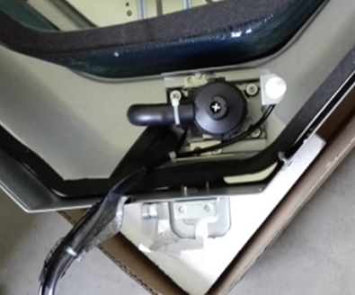
E4 display logic
E4 error code display logic :
Float switch ports on PCB are normally closed circuit , once be disconnected then E4 will be displayed
Float switch working diagram
Float down connect
Float up disconnect
PUMP port
water drainage pan
Full of water
Float switch port

Slide 17
E4 Trouble shooting Guide
Check PCB
Remove float switch wiring, short connect Float switch port
Replace
PCB
E4 error
Error
exists
no error
Check water drainage pan
Whether full of water
Check float switch
Manual change the float to up and down (＞1 min)
No
Replace
Float switch
Error
exists
yes
Up-error
Down – no error
Adjust the water drainage pipe or clean the water drainage pan
E4 come again
after a while
Check the drain pump
Whether it can drain water normal
abnormal
Replace the drain pump

Slide 18
Total 13 error codes
Temp. sensor fault
F9 High pressure Switch Protection
Communication fault
E9 Low pressure switch protection
IDU fault
E0 Lack of refrigerant
Refrigerant circuit fault(5)
E6 Phase sequence abnormal
EA Discharge temperature too high

Slide 19
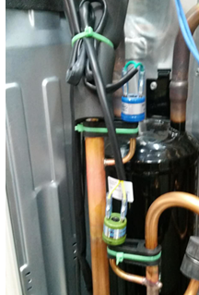
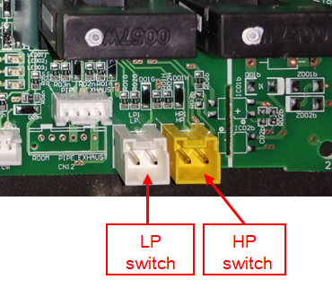
F9/E9 display logic
F9/E9 error code display logic :
HP and LP switch ports on PCB are Normally closed circuit , once be disconnected then F9/E9 will be displayed
Each port contain two point

Slide 20
F9/E9 Troubleshooting Guide
Check HP/LP switch
Reconnect switch wiring to PCB，power reset
Replace
switch
Error
exists
F9/E9 error
No error
Check HP/LP port and PCB
Remove wiring， short connect two
Point, then power reset ,
No error
Check installation of ODU
Whether poor heat exchange of ODU
Improve installation
Yes
Error Still exists
No
Replace PCB
Check the refrigerant system
Whether poor performance of indoor side
Whether abnormal current、 high pressure value
Vacuum pump, Check Air tightness, recharging refrigerant

Slide 21
Total 13 error codes
Temp. sensor fault
F9 High pressure Switch Protection
Communication fault
E9 Low pressure switch protection
IDU fault
E6 Phase sequence abnormal
Refrigerant circuit fault(5)
E0 Lack of refrigerant
EA Discharge temperature too high

Slide 22
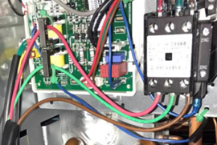
E6 display logic
E6 Phase sequence abnormal logic :
Two current transformer detect the real time current of compressor wiring , once these
Two current value big different or no current , then F6 error be display
Two Current transformer
AC
contactor
Compressor red wiring
Compressor green wiring

Slide 23
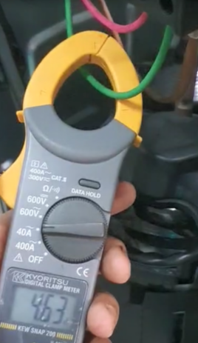
E6 Trouble shooting Guide
Check compressor wiring
Whether compressor wiring go through current transformer
E6 error
Reconnect
no
yes
Check ODU power supply
Change the phase sequence of
Power supply
Error Still
exists
Check compressor wiring current value
current clamp test current
Replace current transformer
No error
same
Ok
Big different
Check compressor & compressor terminal wire
Make sure correct wiring

Slide 24
Total 13 error codes
Temp. sensor fault
F9 High pressure Switch Protection
Communication fault
E9 Low pressure switch protection
IDU fault
E6 Phase sequence abnormal
Refrigerant circuit fault(5)
E0 Lack of refrigerant
EA Discharge temperature too high

Slide 25
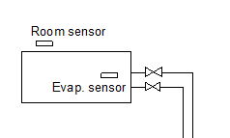
E0 display logic
E0 Lack of refrigerant logic :
After compressor working more than 6min, if detect TR-TE d＜2℃， then E0 error will be display
TR
TE
Indoor Units

Slide 26
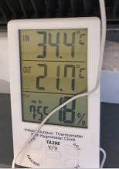
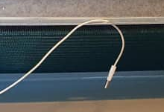
E0 Trouble shooting Guide
E0 error
Check TR sensor
Repower and operation cooling
Mode , detect air return and air outlet temperature difference
＜2℃
Check TE sensor
Touch the Evaporator ,whether low temperature
Replace
TE sensor
yes
＞2℃
NO
Replace
TR sensor
Check installation of ODU
Whether poor heat exchange of ODU
Improve installation
no
Vacuum pump, Check Air tightness, recharging refrigerant

Slide 27
Total 13 error codes
Temp. sensor fault
F9 High pressure Switch Protection
Communication fault
E9 Low pressure switch protection
IDU fault
E6 Phase sequence abnormal
Refrigerant circuit fault(5)
E0 Lack of refrigerant
EA(F2) Discharge temperature too high

Slide 28
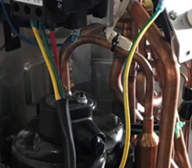
EA(F2) display logic
EA(F2) Discharge temperature too high logic :
Compressor discharge temperature sensor detected Td ≥120℃ and Lasts for 10s, whole system will stop running, then EA（F2） error be display
Exhaust(Discharge)
Temperature sensor

Slide 29
EA（F2） Trouble shooting Guide
Check fan motor
Whether IDU and ODU fan can run normally
EA(F2) error
Replace
Fan motor
no
yes
Check temperature sensor
check exhaust temperature of
The exhaust piping
High
Check installation of ODU
Whether poor heat exchange of ODU
Improve installation
Low
temperature
Replace
sensor
no
Check the refrigerant system
Whether poor performance of indoor
Yes
Vacuum pump, Check Air tightness, recharging refrigerant
Abnormal noise of compressor
Error again
Replace compressor

