Slide 1

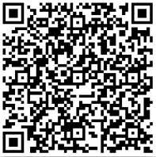
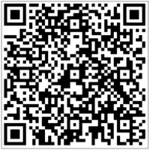

6
WIFI usage
Intelligent remote control
Operate Program 1
APP Download
Android IOS
Search the APP “AC Freedom”

Slide 2
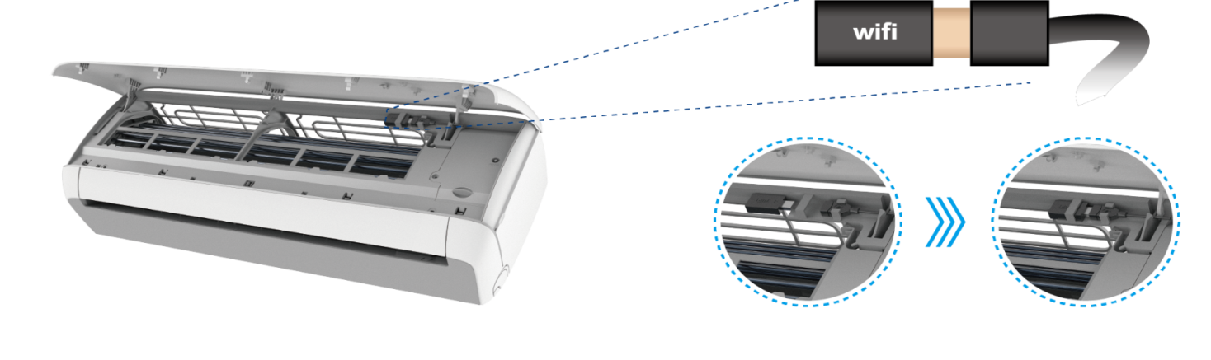
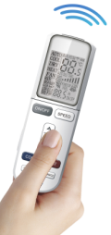
6
WIFI usage
Operate Program 2
If first time to connect or change the Router, it needs to reset the WIFI device:
Press the “health” button 8 times(AC will beep 8 times), then the AC will beep twice

Slide 3
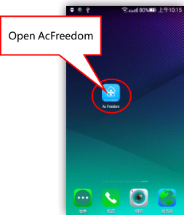
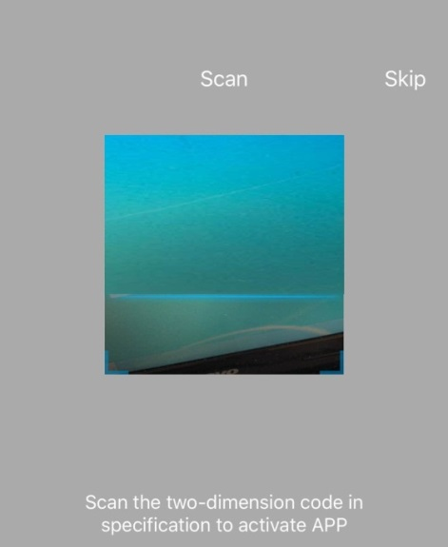
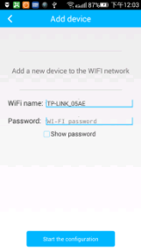
6
WIFI usage
Operate Program 3
Connect the WIFI, then run the APP “AUX Freedom” enter into “device list”.
Press “skip”, then press “add device”the WIFI name will appear automatically, then you just enter the password，and press “start the configuration”

Slide 4
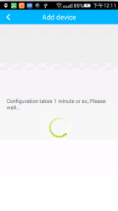
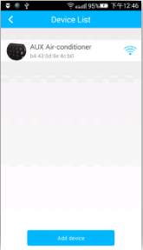
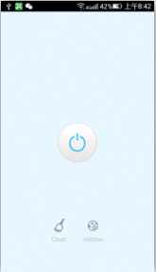
6
WIFI usage
Operate Program 4
It takes nearly 1 min to reset. After it finished, you can find the AC in “device list”

Slide 5
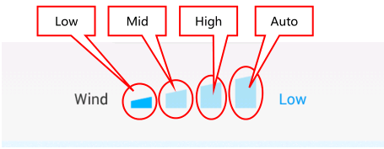
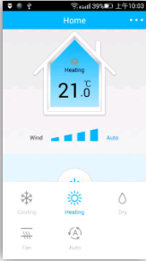
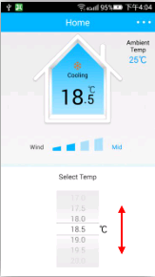
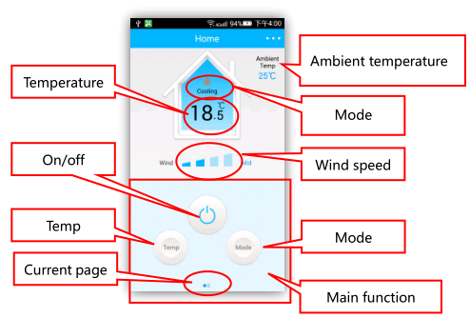
6
WIFI usage
Operate Program 5
When connected, you can control the operation of the air conditioner through the mobile phone.
The following focuses on power control

Slide 6
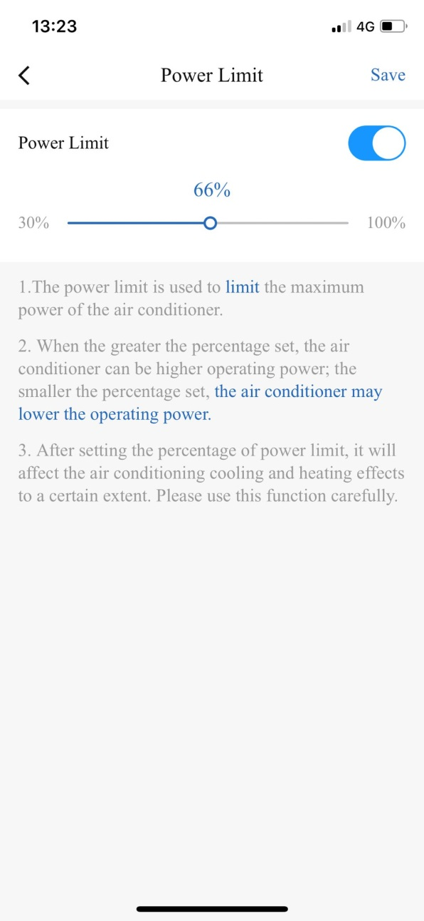
6
WIFI usage
Usage of power control
Too many household appliances, power is too large, want to run but not too high power;
It can realize 30%~100% stepless power control and independent energy-saving control through WIFI

Slide 7
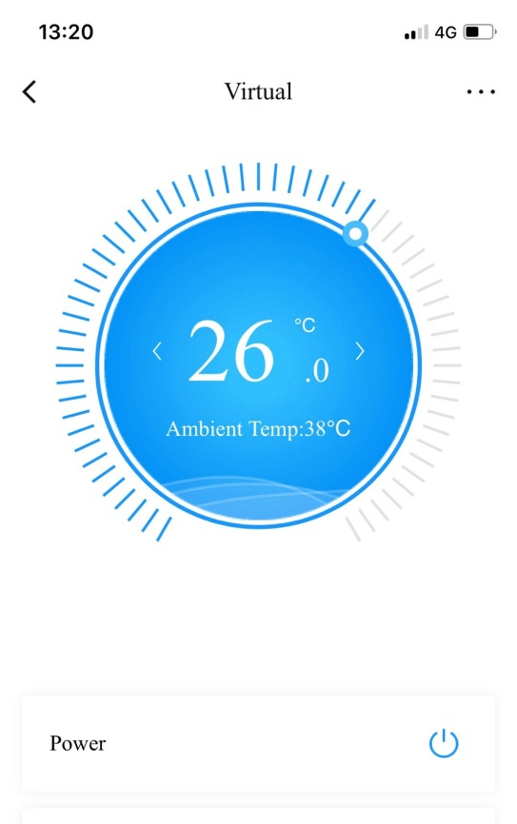
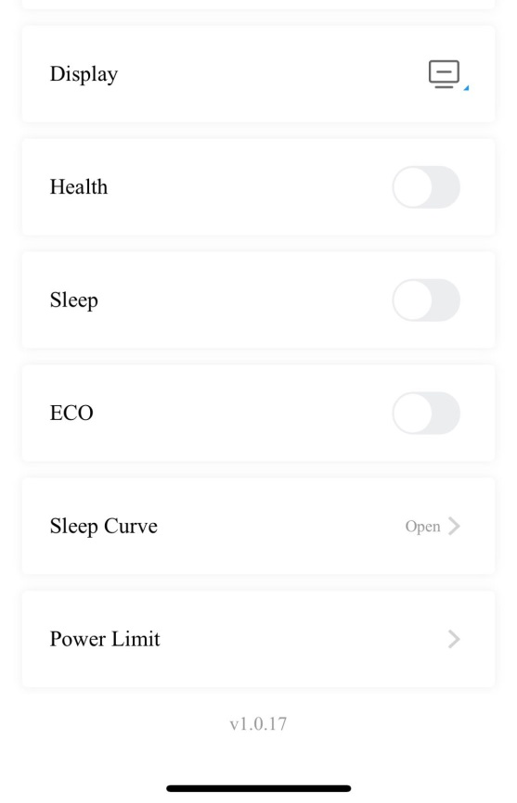
6
WIFI usage
Steps 1
When WIFI is turned on, select the lowest option for electrical control

Slide 8
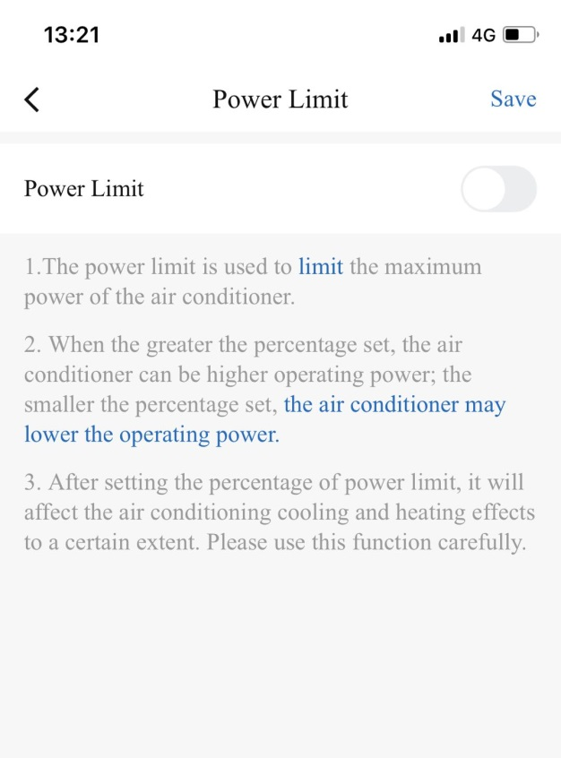
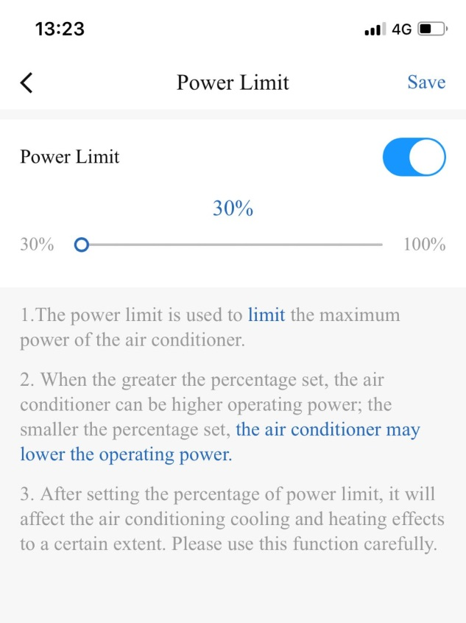
6
WIFI usage
Steps 2
Click the slider and go to open
Reliable look electricity control and regulation range 30%-100%

Slide 9
6
WIFI usage
Steps 3
You can adjust the power ratio by holding down the small circle and dragging, and then click save

Slide 10

6
WIFI usage
Steps 4
After saving, automatically jump to the main interface, and display the proportion of electricity control;
BACK

Slide 11
Thanks！

